Slide 1
Samsung CAS vs ks-nav
 | CAS | ks-nav
Overview | CAS, a software suite for large source code maintenance, offers two tools generating metainfo. These tools cover build-related and source code-related information. | ks-nav, a tool for Linux kernel analysis for generating call tree graphs and user-friendly web interface for interactive static analysis. It aids Linux kernel experts by offering detailed diagrams showcasing functional module interactions within the kernel.
Tools | 2: (BAS, FTDB) | 3: (kern_bin_db, nav, nav_web)
Deps | (Python, LLVM, RapidJSON) | (Radare2, binutils, Graphviz)
input | Software build tree | Linux Kernel build tree
output | Metainfo (JSON, DB Document) | Metainfo (DB relational, diagrams)
Notes:
Hey folks, today let's dive into a comparison that's a bit like comparing apples and pears - Samsung CAS and ks-nav. They're both in the software analysis game, but trust me, they're as different as night and day.
First up, we've got Samsung CAS, the all-rounder. It claims it can analyze any source code, but here's the catch: it's a C only thing. CAS's main task is collecting info from both the build process and the source tree. It's on a mission to help developers tame those big source trees.
Now, let me introduce you to ks-nav, the specialist. It's got its eyes set on one specific source tree: the Linux kernel. Talk about dedication, right? This tool is all about the binary kernel image, extracting secrets from the binary clues. And what's its magic trick? Creating diagrams.

Slide 2
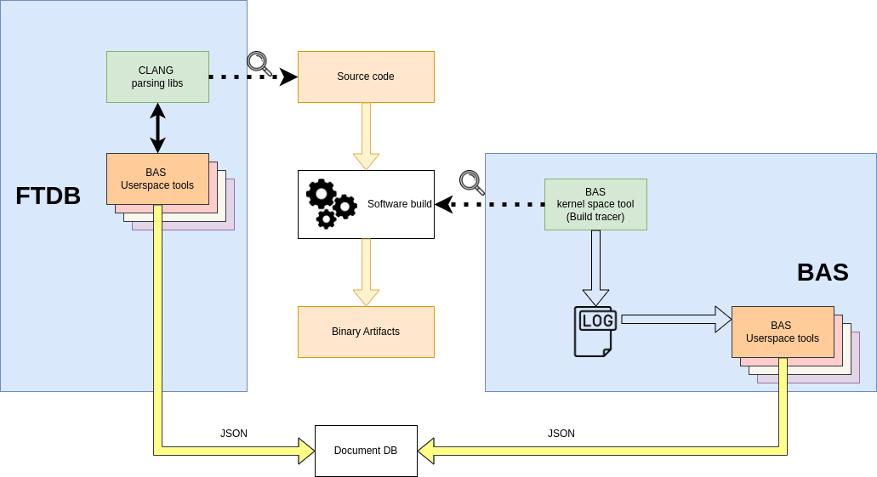
CAS - Overview
Build Awareness Service (BAS)
Function/Type Database (FTDB)
Notes:
CAS is featured by two tools: BAS and FTDB, each with its distinct role.
In the diagram, watch as BAS swoops in to collect data straight from the building process, using its OOT LKM that logs every move during the build.
Later, companions Python tools analyze this log, collecting info from the build process.
On the other side, we have FTDB, leveraging the mighty LLVM Clang to extract information directly from the source code.
The outcome?
A NoSQL database filled to the data.

Slide 3
CAS - BAS
Collects information related to the software build:
Compilers and build tools
Source files used
Makefiles used
Build times statistics
Notes:
So, speaking about the info bas is able to collect we have:
Compilers and build tools
Source files used
Makefiles used
Build times statistics
All them taken from the

Slide 4
CAS - FTDB
Collects information related to the source code.
Function and types
Function signatures, return types and variables
Calls relations
Preprocessor related informations
Notes:
Now it’s the turn of FTDB
Function and types
Function signatures, return types and variables
Calls relations
Preprocessor related informations

Slide 5
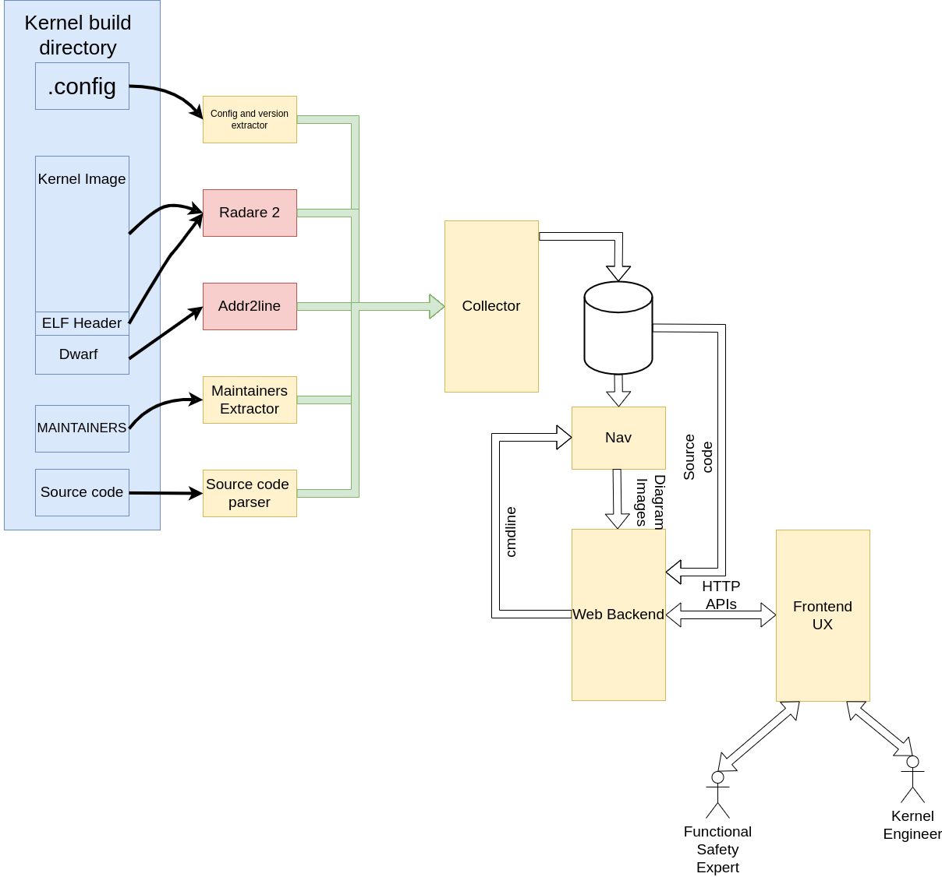
ks-nav - Overview
kern_bin_db
nav
nav_web
Notes:
Here,I play at home, much like asking a barber if you need a haircut.
Nevertheless, ks-nav is a different beast; it do handle the source code, but its focus is solely on the Linux kernel source code.
Its objective, or at least not the foremost one, isn't to gather meta info about the code. Instead, it is about generating diagrams representing specific parts of the code under analysis.
To achieve this, it breaks down the work into three key tasks and employs three tools to carry out these functions:
kern_bin_db: Gathers meta info from the binary artifact vmlinux and the source code, storing it in a database.
nav: Utilizes the information in the database to construct diagrams.
nav_web: Wraps it all up by offering a web-based interface for interactive engagement with the diagrams.

Slide 6
ks-nav - kern_bin_db
Command line tool
Analyzes kernel image (vmlinux ELF) to extract the function call trees.
Fetches complementary informations from DWARF debug info.
Fetches subsystems hierarchy correlating sources files and MAINTAINERS contents.
Fills relational database with extracted info:
Symbols
Subsystems
Kernel configuration
Symbols relationships (the base to create call trees)
Source code references
Notes:
kern_bin_db is the tool that analyzes the kernel binary and fills up the database.
It uses radare2 and addr2line to fetch all the info it needs. There are plans to swap these tools with other equivalent, this discussion lies beyond the scope of our current presentation.
The data it recover is
Symbols
Subsystems
Kernel configuration
Symbols relationships (the base to create call trees)
Source code references

Slide 7
ks-nav - nav
Command line tool.
Uses the database to create static diagrams.
Selects modes view:
Functions call trees.
Subsystem dependencies.
Subsystem transition actions.
Applies filters:
Do not expand functions.
Do not include functions.
Notes:
Nav is the tool that produce the actual diagrams: It requires a starting point and produces diagrams that focus on the given function.

Slide 8
ks-nav - nav_web
Provides a web interface to interact with diagrams.
Allows to select view modes.
Allows to apply filters.
Notes:
ks_nav is akin to nav, but it opts for the web interface over the command line. While this might sound modest, there are ambitious plans in the pipeline to broaden the tool's capabilities, introducing features like diagram generation and kernel source code browsing. This tool serves as the gateway to furnish additional insights into the code, which would be challenging within the constraints of a static diagram image.
As of now, the tools deliver the core functionality of nav through a web interface.

Slide 9
Contrasts and Conclusions
 | CAS | ks-nav
What Scope do it have | General (c source) | Linux kernel only
What is the declared goal? | Support large codebase software developers | Support Linux kernel engineer
What do it provides? | Collects metadata about the source and the buid | Creates several kind of diagrams
How does it? | Parses the source code and spies the build process | Analyzes the kernel binary image and uses debug information
Notes:
In this final slide, let's tackle some key questions that shed light on why comparing CAS and ks-nav, despite their differences, can be meaningful.
Scope: CAS has a broad scope, aiming to tackle all C software. ks-nav, on the other hand, aims at the Linux kernel exclusively.
Goal: CAS sets out to assist developers in managing large code bases effectively. ks-nav is designed to aid kernel engineers in their analysis tasks.
Outcome: CAS collects and stores data in a NoSQL database. ks-nav, while also collecting data and storing it in a structured database, this is functional to its primary objective which is to provide diagrams.
Data Collection CAS goes about data collection by parsing the source code and employing a LKM to monitor the build process. ks-nav, in contrast, delves into the binary product of kernel compilation for its analysis.
In essence, while both CAS and ks-nav belong to the realm of software analysis, they are fundamentally different products.

